Slide 1

CMR Technical Campus Department of Information Technology
Major Project Stage-II
Review-2
Project Title: A Comparative Hybrid Deep Learning
Study of Twitter Sentiment
on the Russia-Ukraine War.
Project Supervisor:​
Name:​M.Sivajyothi
Designation: Assistant Professor
Presented By:​
Batch No: 4
1)H. No: 227R1A1220 Name:G.PRANEETHA
2)H. No: 227R1A1212 Name:CH.SRIDHAR
3)H. No: 227R1A1260 Name:V.VAMSHI
​

Slide 2

CONTENTS
Introduction & Overview
Existing System
Disadvantages
Proposed System
Advantages
Software and Hardware Requirements
Novelty of the project
Architecture
Modules
UML Diagrams
Source Code
Results
Conclusion & Future Enhancement
References
GitHub Link

Slide 3
INTRODUCTION & OVERVIEW
This study introduces a deep-learning model for analyzing public sentiment on Twitter about the Russia–Ukraine war. It uses RoBERTa, a powerful language model, combined with an ensemble classifier to better understand tweets written in multiple languages, including those with sarcasm or emojis. The data is cleaned while keeping important elements like hashtags and mentions. The analysis also shows changes in public opinion over time and across regions. Compared to older methods, this model is more accurate and context-aware, making it useful for policymakers and researchers to track real-time public opinion during global conflicts.

Slide 4
EXISTING SYSTEM
The current standard uses Manual sentiment monitoring where human analysts scan and tag content.
Many automated systems use basic Machine Learning (ML) classifiers.
These basic classifiers rely on handcrafted features (like counting words/n-grams, lexicons, or polarity scores).
The existing systems are challenged by the massive volume of data (Twitter logged over 20 million war-related tweets in the first month alone).

Slide 5
DISADVANTAGES OF EXISTING SYSTEM
Manual systems are slow, non-scalable, and suffer from annotator bias and inconsistency.
Traditional automated methods lack deep contextual understanding.
They fail on complex Twitter language such as code-mixed inputs, sarcasm, abbreviations, and emoji-driven sentiment.
They often produce noisy or misleading aggregate sentiment measures.
Existing ML models have limited feature representation and weak generalization across unseen data.

Slide 6
PROPOSED SYSTEM
A hybrid sentiment classification framework is introduced.
It uses RoBERTa for deep contextual understanding of tweets (captures sarcasm, code-mixing, and language nuances).
An ensemble of ML classifiers (like multiple models combined) improves accuracy, precision, and stability.
This method handles large-scale, noisy, multilingual Twitter data better than existing systems.
Useful for tracking public opinion shifts during geopolitical crises.

Slide 7
ADVANTAGES OF PROPOSED SYSTEM
RoBERTa captures deep semantic and contextual features, overcoming the limitations of traditional models in handling sarcasm and nuanced language.
The ensemble classifier ensures higher accuracy, precision, and recall by combining complementary strengths.
It provides more stable and reliable sentiment predictions.
The system delivers more reliable public-opinion signals for policymakers, researchers, and media analysts.
It is a robust and practical tool for monitoring real-time opinion dynamics during geopolitical crises.

Slide 8
SOFTWARE & HARDWARE REQUIREMENTS
SOFTWARE REQUIREMENTS:
HARDWARE REQUIREMENTS:
Python: 3.12.0
Operating system: Windows
Frontend: Tkinter
Database: Redis
Processor: Intel i5
Memory: 1 TB (storage)
RAM: 8 GB

Slide 9
NOVELTY OF THE PROJECT
Comparative Study – Compares multiple machine learning and deep learning models to find the best one.
Hybrid Framework – Combines RoBERTa, deep learning, and a tree-based classifier for better results.
Context-Aware Analysis – Understands the real meaning of tweets, including emotions and sarcasm.
Class Balancing – Uses SMOTE to balance positive, neutral, and negative tweets.
Real-Time Design – Supports fast and continuous analysis of Twitter sentiment.

Slide 10
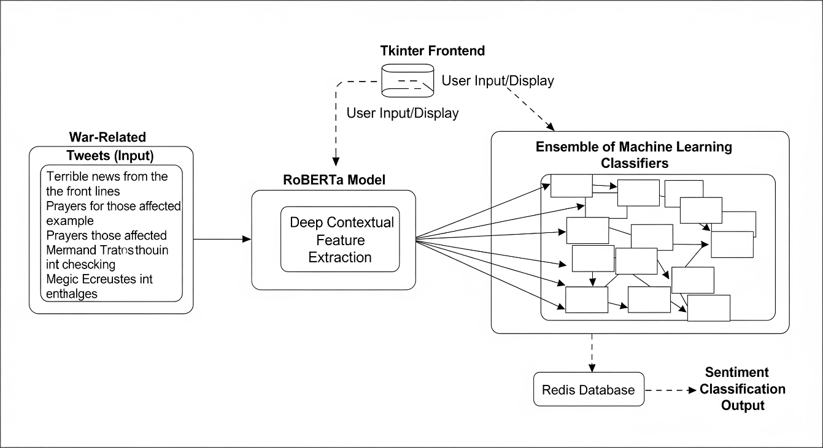
ARCHITECTURE

Slide 11
MODULES
1. Data Gathering
Tweets are collected from Twitter using war-related keywords and hashtags (like #Ukraine, #Russia, #RussiaUkraineWar).
The data includes text, emojis, hashtags, and mentions in different languages.
All the collected data is stored safely in a Redis database for easy access.
2. Data Preprocessing
The tweets are cleaned to remove unwanted things like links, symbols, and extra spaces.
Important parts such as hashtags, emojis, and mentions are kept because they show emotions.
Text is converted into a proper format by handling multiple languages, slang, and abbreviations.

Slide 12
3. Text Vectorization / Representation
The RoBERTa model is used to change the text into numbers (called embeddings).
These embeddings help the computer understand the meaning and emotion behind each tweet.
This step captures sarcasm, mixed languages, and deeper context from tweets.
4. Model Building
A hybrid model is created using two parts:
RoBERTa for understanding and converting text into meaningful data.
Ensemble of classifiers (like Random Forest, SVM, etc.) that work together to decide the tweet’s sentiment (Positive, Negative, Neutral).
This combination makes the predictions more accurate and reliable.

Slide 13
5. Model Evaluation
The model is tested to check how well it works.
Common measures like Accuracy, Precision, Recall, and F1-score are used.
The results are compared with older methods to show that this new hybrid model performs better.
6. Prediction
The model is used to predict the sentiment of new tweets in real time.
New tweets are cleaned, converted into embeddings, and then passed through the trained model.
The final output (Positive, Negative, or Neutral) is shown through a Tkinter GUI interface.

Slide 14
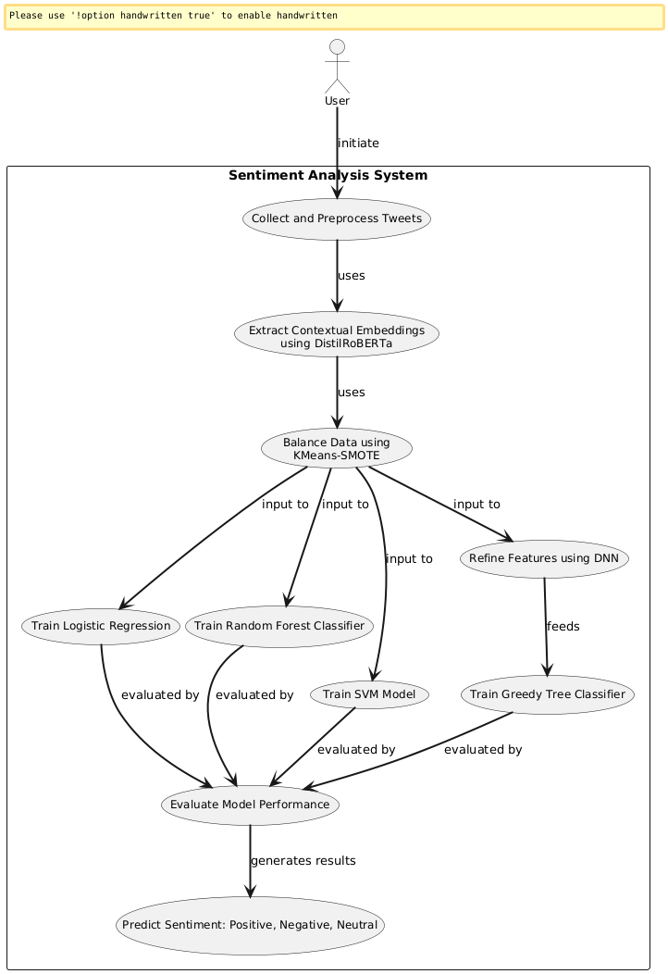
UML DIAGRAMS
Use Case Diagram:

Slide 15
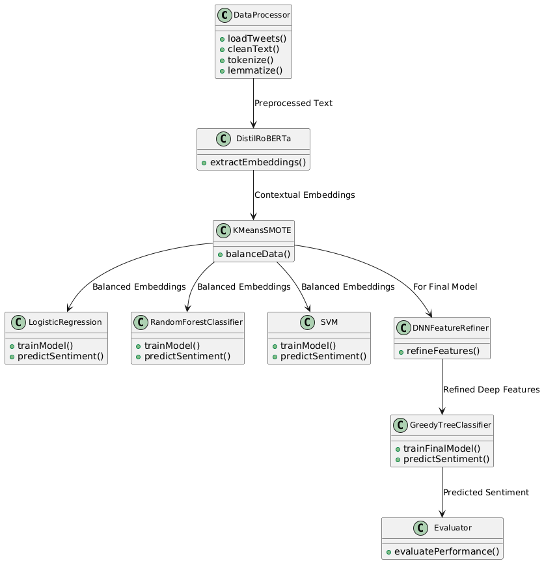
Class Diagram:

Slide 16
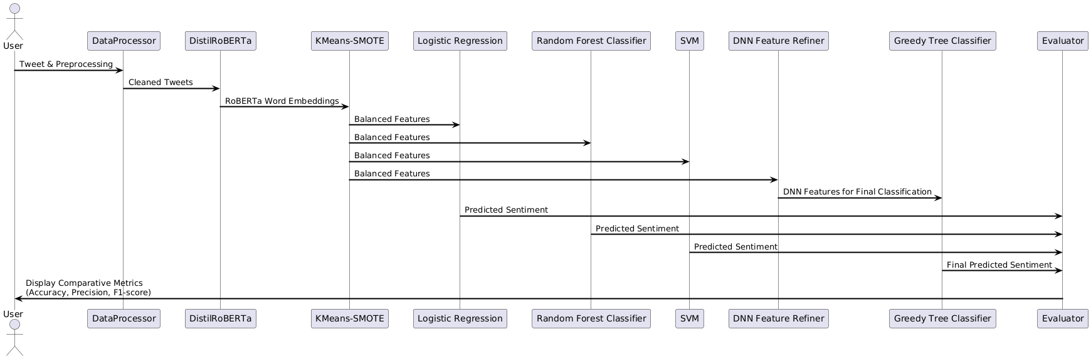
Sequence Diagram:

Slide 17
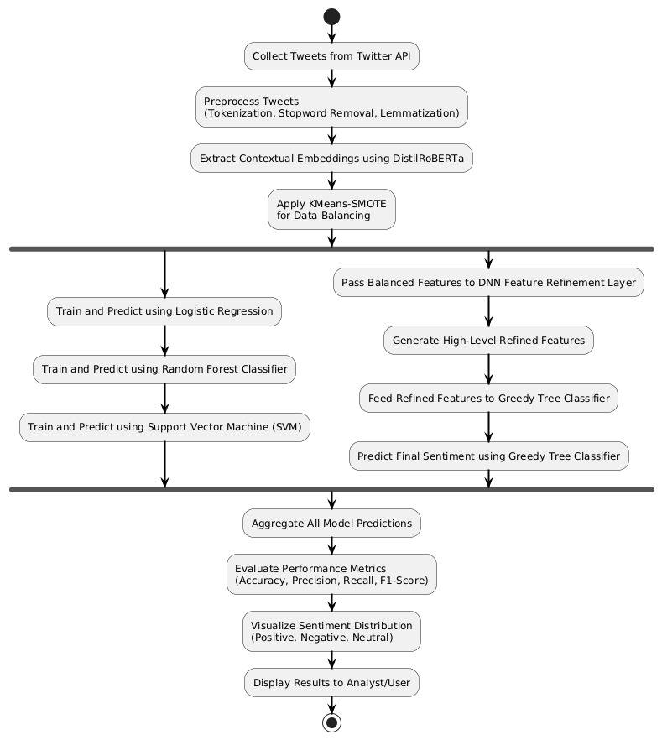
Activity Diagram:

Slide 18
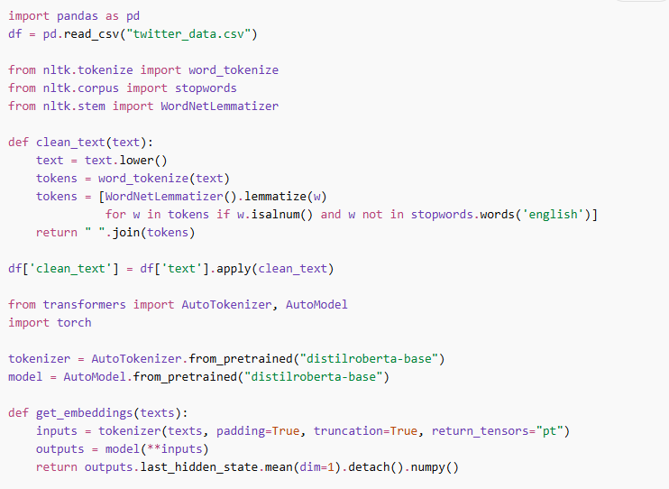
SOURCE CODE

Slide 19
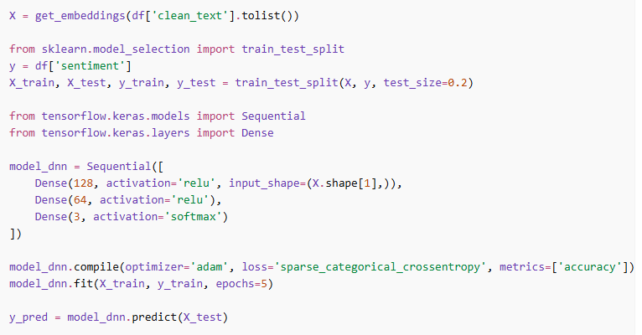

Slide 20
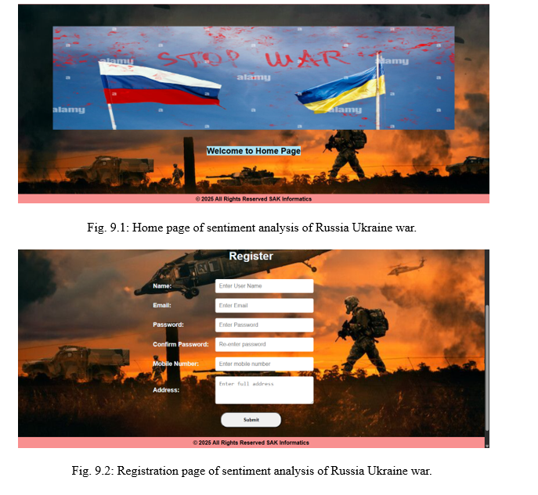
RESULTS

Slide 21
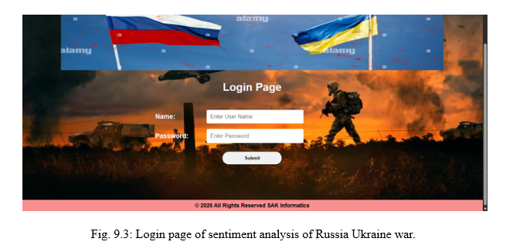
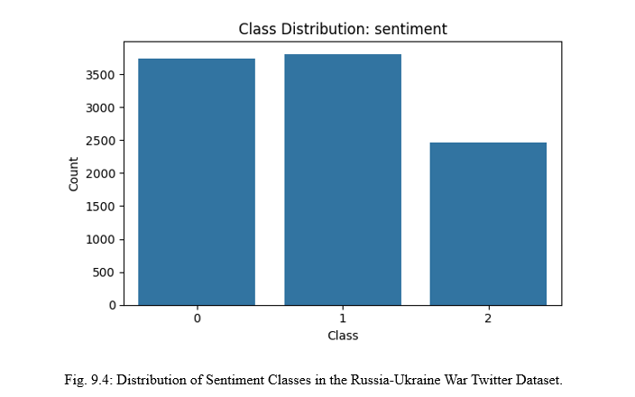

Slide 22
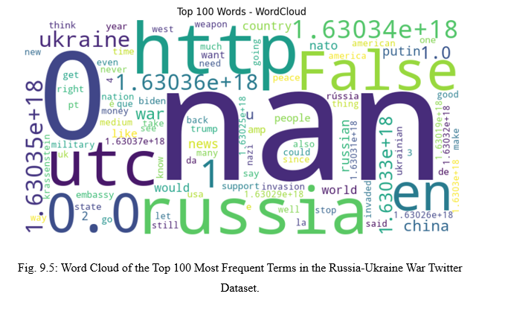
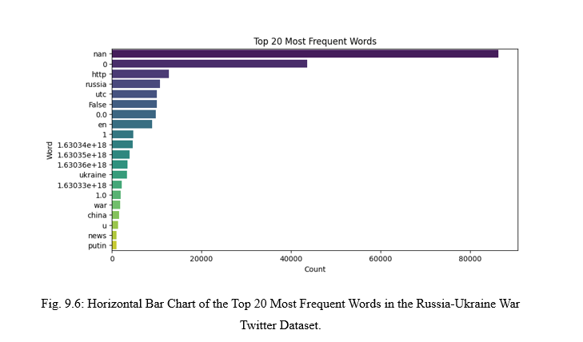

Slide 23
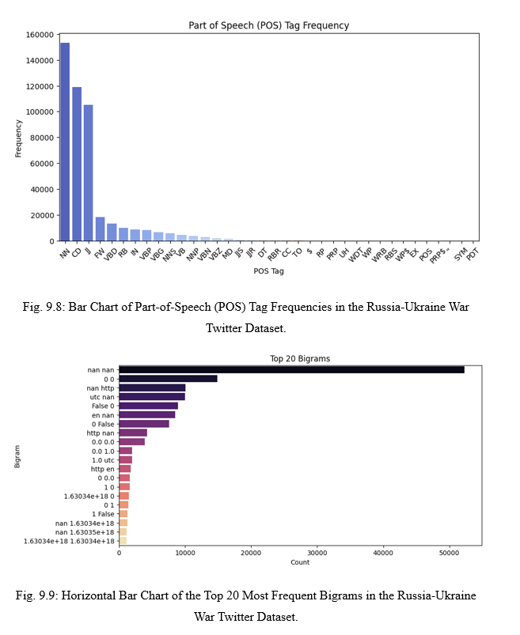

Slide 24
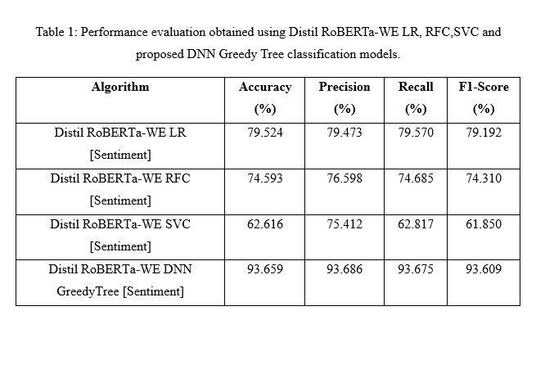

Slide 25
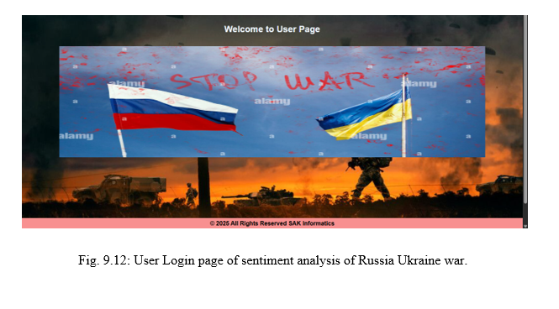

Slide 26
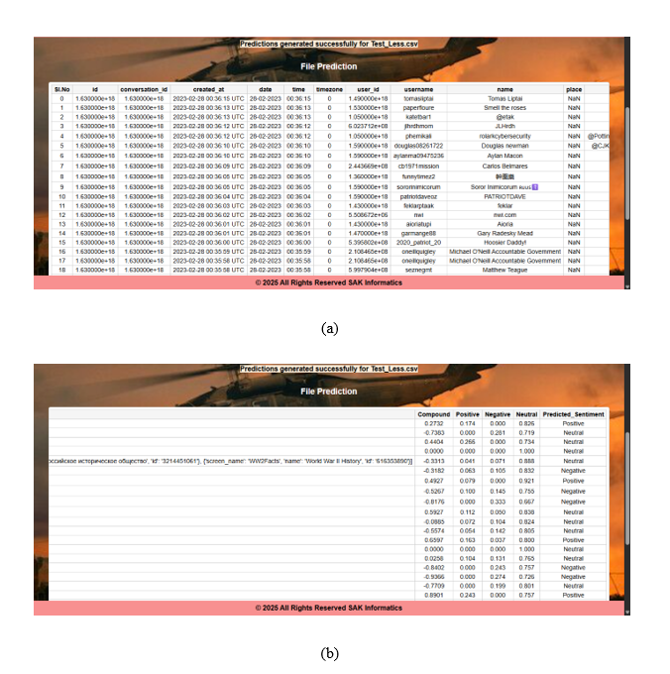

Slide 27
Conclusion & Future Enhancement
This study created a fast and accurate system to understand people’s opinions on the Russia-Ukraine war using Twitter data. It performs much better than traditional methods and handles issues like unbalanced data effectively. The results show that most people express negative or neutral feelings about the war. Overall, this system is useful for tracking public opinion in real time, and it can be improved further by adding support for more languages and different types of data in the future.
Future work will extend the framework to multilingual sentiment analysis, incorporate temporal dynamics for tracking opinion shifts, and integrate multimodal data (images/videos) to enhance contextual understanding and predictive accuracy.

Slide 28
References
Liu, Y.; Wang, S.; Yu, S. A Bullet Screen Sentiment Analysis Method That Integrates the Sentiment Lexicon with RoBERTa-CNN. Electronics, 2024, 13, 3984. https://doi.org/10.3390/electronics13203984
Pratibha; Kaur, A.; Khurana, M.; Damaševičius, R. Multimodal Hinglish Tweet Dataset for Deep Pragmatic Analysis. Data, 2024, 9, 38. https://doi.org/10.3390/data9020038
Wang, Z.; Li, L.; He, K.; Zhu, Z. User Profile Construction Based on High-Dimensional Features Extracted by Stacking Ensemble Learning. Applied Sciences, 2025, 15, 1224. https://doi.org/10.3390/app15031224
Simionescu, M. Machine Learning vs. Econometric Models to Forecast Inflation Rate in Romania? The Role of Sentiment Analysis. Mathematics, 2025, 13, 168. https://doi.org/10.3390/math13010168

Slide 29
GitHub Link
https://github.com/PRANEETHAGUNJARI/MAJOR-PROJECT

Slide 30


